Slide 1
Source Management Tool
Why We Use Git

Slide 2
History
1st Version Control
No Networking
RCS, SCCS
2nd Version Control
Centralized
3rd Version Control
Distributed
Commit before Change
One file at a time
Locks
Multi-file
Merge before commit
CVS, SVN, TFS
Changesets
Git, HG/Mercuiral

Slide 3
Difference
CVS
SVN(Subversion)
HG(Mercurial)
GIT

Slide 4
Migrate SVN to GIT
Commit is not final step
Pull – Merge – Commit - Push
Rebase
Stash

Slide 5
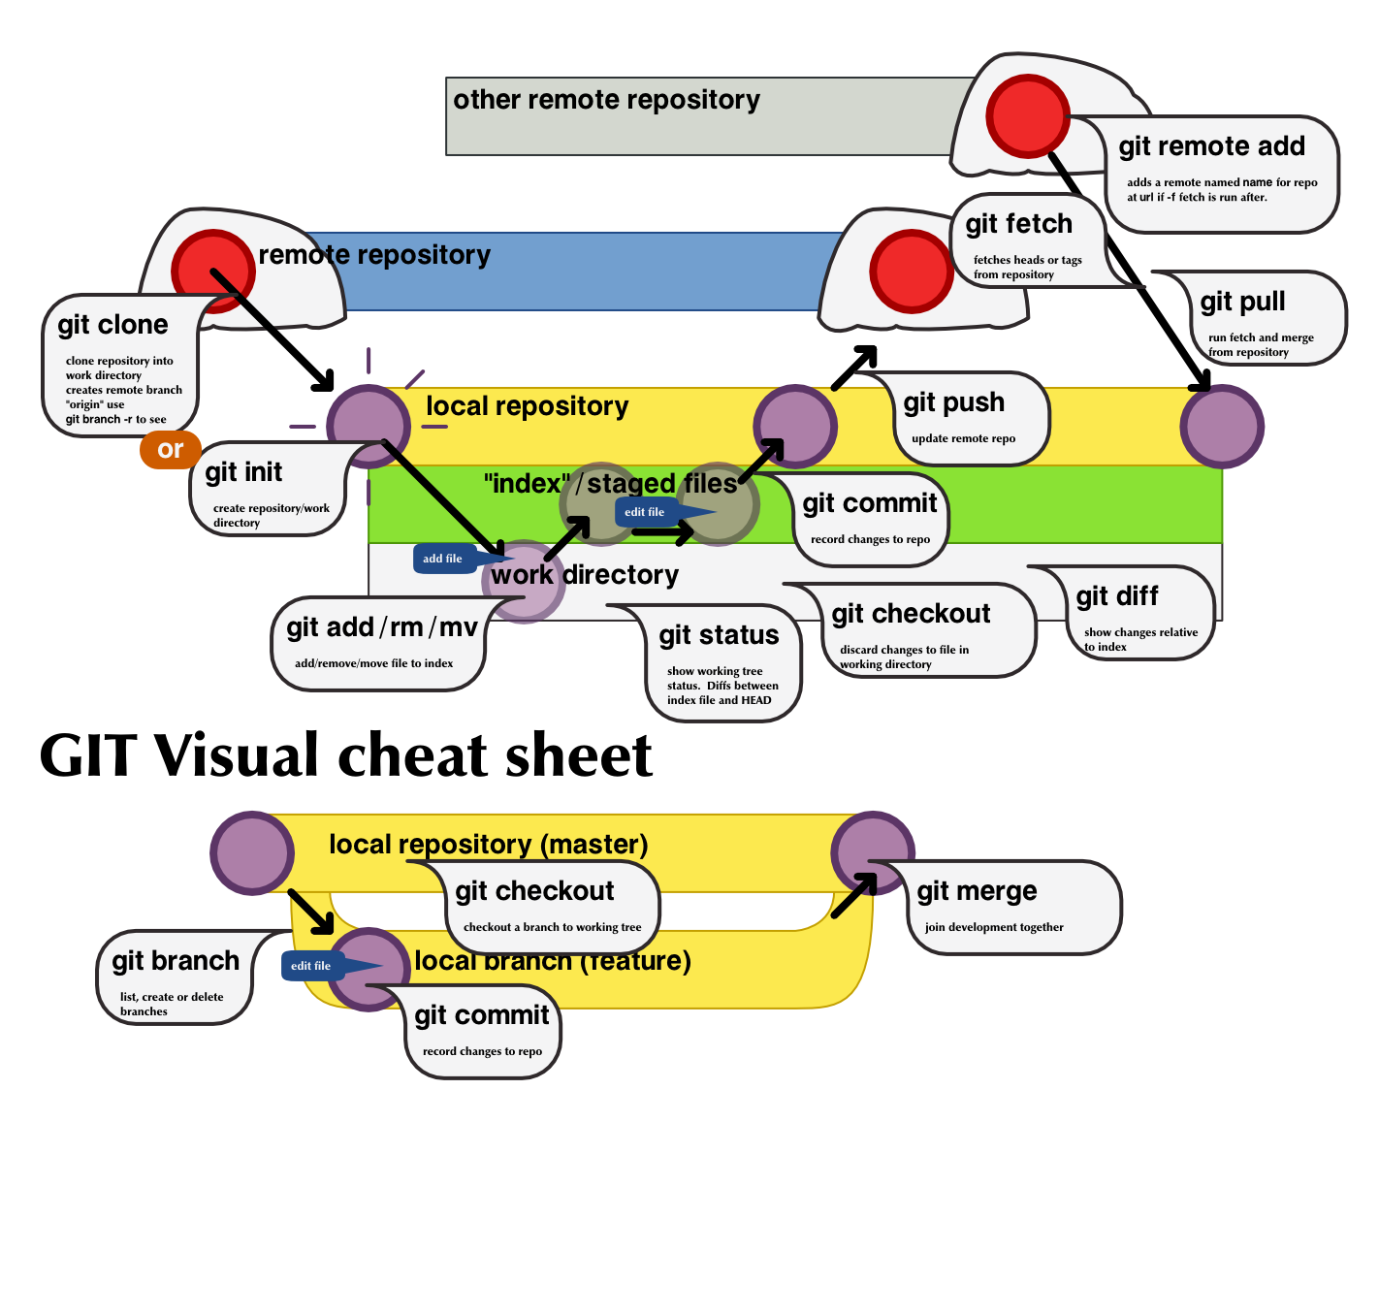
GIT workflow

Slide 6
Git Commands

Slide 7
Q&A

